Slide 1
















INT104 – Database Management System Unit – II

Slide 2

Normalization
4 NF
5 NF
Denormalization
2

Slide 3
Acknowledgement
https://www.studytonight.com/dbms/fourth-normal-form.php
https://www.geeksforgeeks.org/introduction-of-4th-and-5th- normal-form-in-dbms
https://www.nielit.gov.in/gorakhpur/sites/default/files/Gorakhp ur/Alevel_1_DBMS_08_June_2020_AV.pdf
3

Slide 4
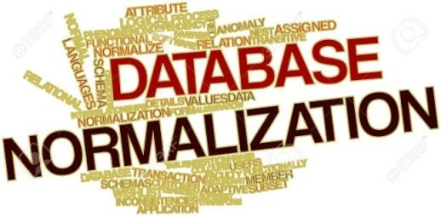
Stages of Normalisation
Boyce-Codd normal form (BCNF)
Remove multivalued dependencies
Remove remaining anomalies
Fourth normal form
(4NF)
Fifth normal form
(5NF)

Slide 5
Fourth Normal Form

Slide 6

Fourth Normal Form
Fourth normal form (4NF) is Introduced by Ronald Fagin in 1977
4NF is the next level of normalization after Boyce – Codd normal form (BCNF).
Fourth Normal Form comes into picture when Multi-valued Dependency occur in any relation.
Multi-valued Dependency – What?
How to remove it and make any table satisfy the fourth normal form?

Slide 7
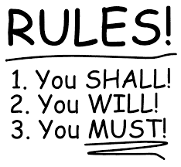
Rules for
4th Normal Form
For a table to satisfy the Fourth Normal Form, it should satisfy the following two conditions:
It should be in the Boyce-Codd Normal Form.
The table should not have any Multi-valued Dependency.

Slide 8

What is Multi-valued Dependency?
A table is said to have multi-valued dependency, following conditions are true.
if the
For a dependency A → B,
If for a single value of A,
Multiple value of B exists,
then the table may dependency.
have
multi-valued

Slide 9

What is Multi-valued Dependency?
A table should have at-least 3 columns for it to have a multi-valued dependency.
For a relation R(A,B,C), if there is a multi-valued dependency between, A and B, then B and C should be independent of each other.
If all these conditions are true for any relation(table), it is said to have multi-valued dependency.

Slide 10
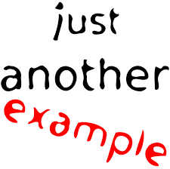
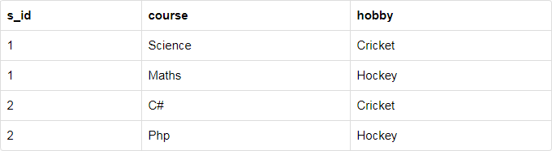
Example
College Enrollment Table
college enrolment table with columns s_id, course and hobby.

Slide 11
Example
College Enrollment Table
In the table
Student with s_id 1 has opted
for two courses, Science and Maths, and
has two hobbies, Cricket and Hockey.
S_id->->Course
S_id->->Hobby
->-> Notation for MultivaluedDependancy

Slide 12
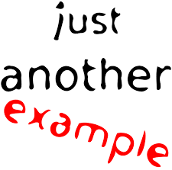
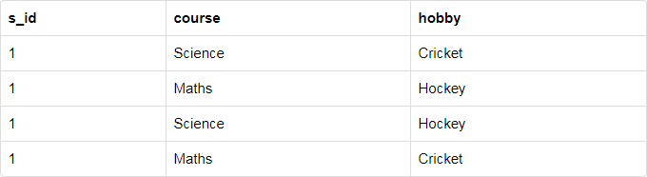
Example
Well the two records for student with s_id 1, will give rise to two more records, as shown below, because for one student, two hobbies exists, hence along with both the courses, these hobbies should be specified.
And, in the table above, there is no relationship between the columns course and hobby.
They are independent of each other.
So there is multi-value dependency, which leads to un- necessary repetition of data and other anomalies as well.

Slide 13
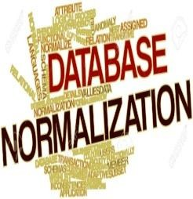
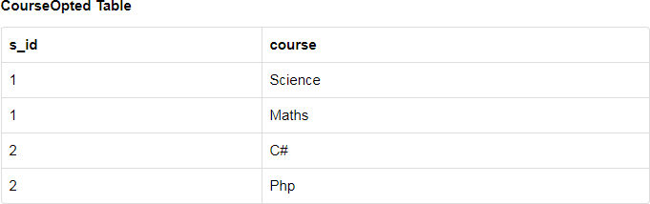
How to satisfy 4th Normal Form?
To make the above relation satisfy the 4th normal form
we can decompose the table into 2 tables.

Slide 14
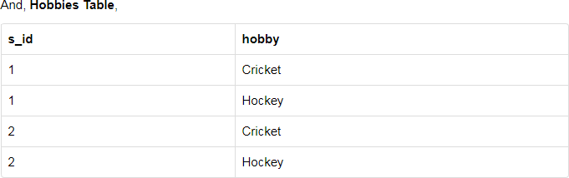
How to satisfy 4th Normal Form?

Slide 15
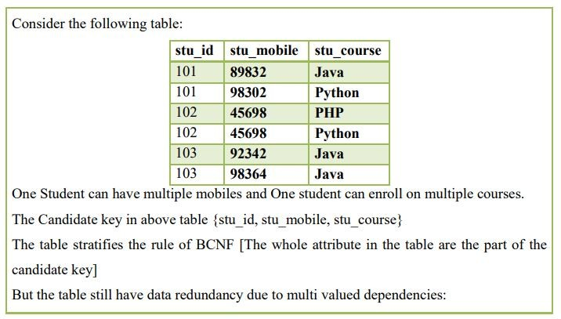
Another Example

Slide 16
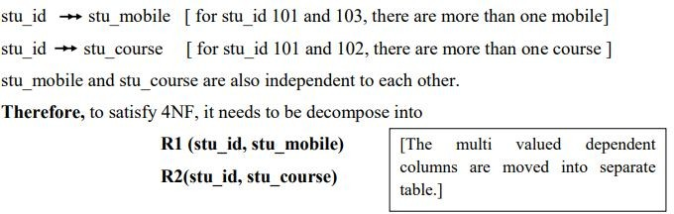
Another Example

Slide 17
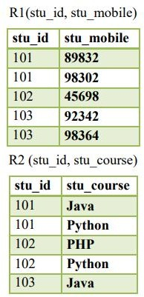
Another Example

Slide 18
Fifth Normal Form

Slide 19
Fifth Normal Form
5NF is also known as Project-Join normal form (PJNF).
A relation is in 5NF if it is in 4NF
It cannot be further non loss decomposed (join dependency)

Slide 20
Fifth Normal Form
A relation
Decomposed into two relations must have loss-less join Property
Which ensures that no spurious or extra tuples are generated
When relations are reunited through a natural join.

Slide 21
Fifth Normal Form
Example – Consider the Company schema, with a case as “if a company makes a product and an agent is an agent for that company, then he always sells that product for the company”.
Under these circumstances, the ACP table is shown as follows:

Slide 22
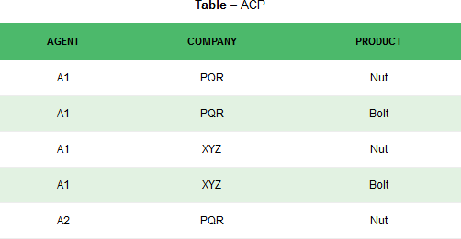
Fifth Normal Form
The relation ACP is again decompose into 3 relations

Slide 23
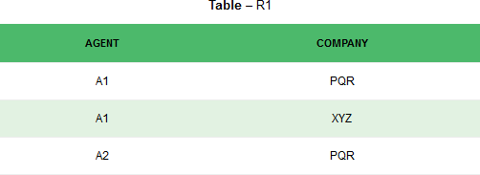
Fifth Normal Form

Slide 24
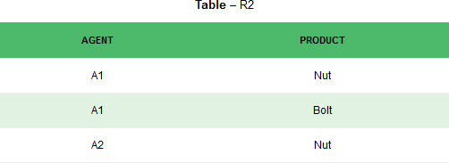
Fifth Normal Form

Slide 25
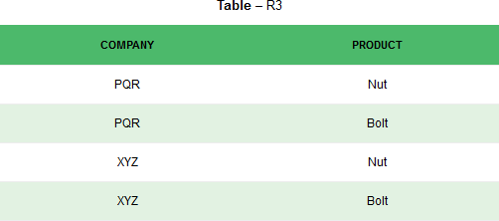
Fifth Normal Form

Slide 26
Fifth Normal Form
Result of Natural Join of R1 and R3 over ‘Company’ and then Natural Join of R13 and R2 over ‘Agent’ and ‘Product’ will be table ACP.

Slide 27
Fifth Normal Form
Hence, in this example,
The decomposition of ACP is a lossless join decomposition.
Therefore, the relation is in 5NF as it does not violate the property of lossless join.

Slide 28
DeNormalization

Slide 29
Denormalization
Normalization is only one of many database design goals.
Normalized (decomposed) tables require additional processing, reducing system speed.
Normalization purity is often difficult to sustain in the modern database environment.
The conflict between design efficiency, information
requirements, and processing speed are
often resolved through compromises that include
denormalization.

Slide 30

Normalization
4 NF
5 NF
Denormalization

Slide 31


